Slide 1
GaN

Slide 2
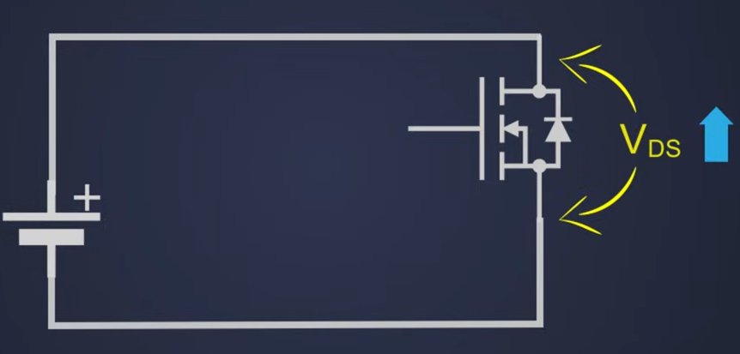
Advantages of using SiC, GaN over Si mosfets
Better Dielectric Breakdown Field Intensity
More Band Gap
Better Heat Conductivity
In Power Applications, we are in need of High Vds

Slide 3
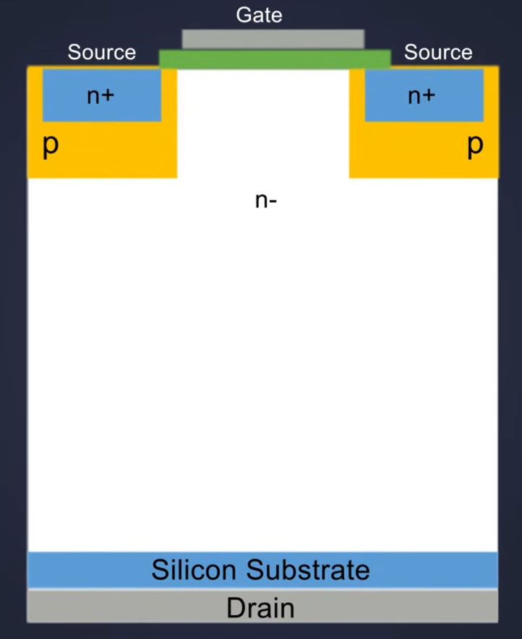
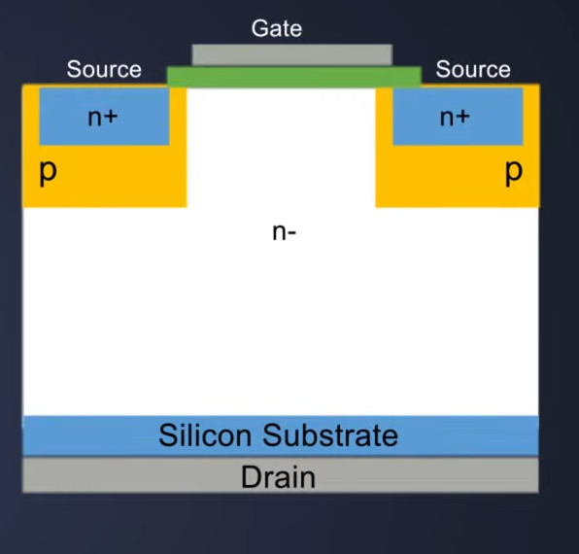
To increase Vds - increase the drift region

Slide 4
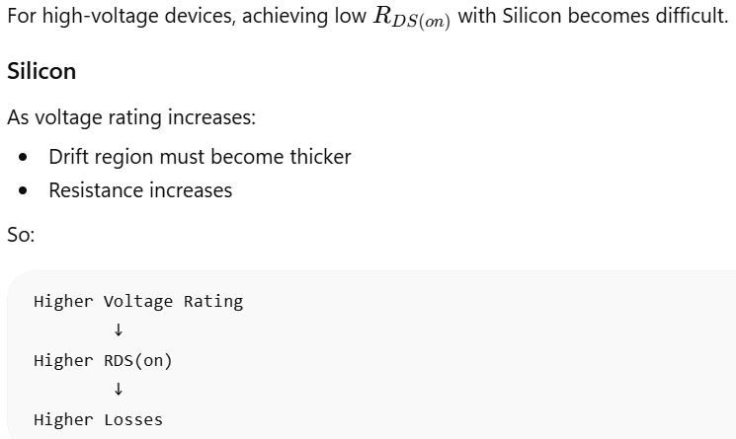
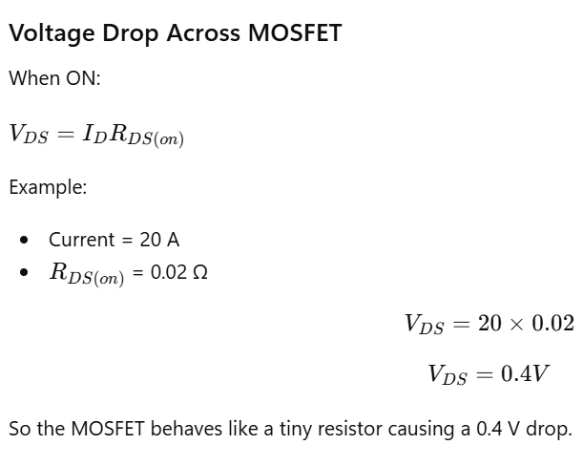
Consequence of increased Drift Region
The resistance between Drain and Source is increased so the loss is increased
This is where SiC and Gan MOSFETs are coming into play.

Slide 5
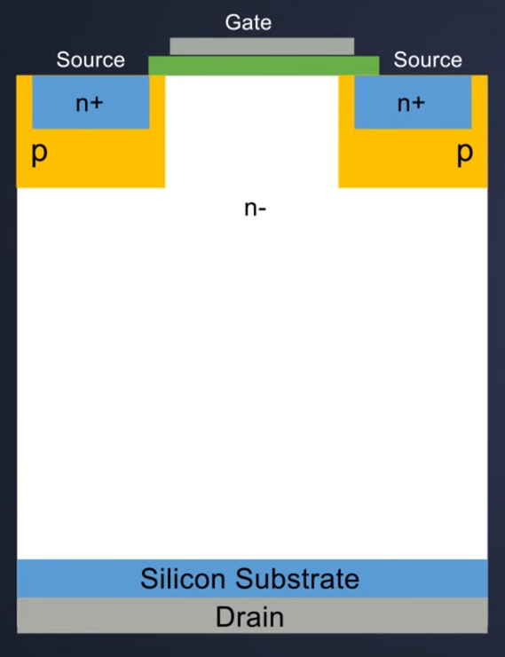
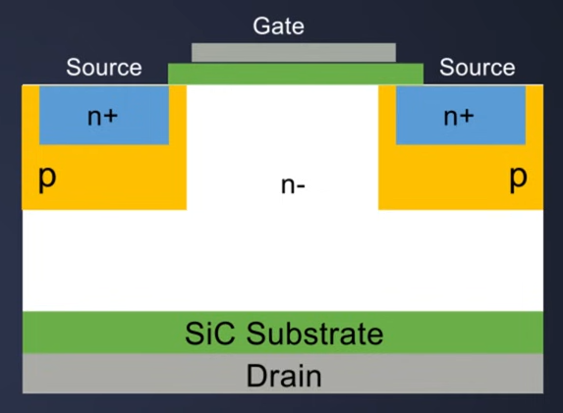
Drift Region of Si Mosfets compared to SiC,GaN
Drift Region Small -> Rds low

Slide 6
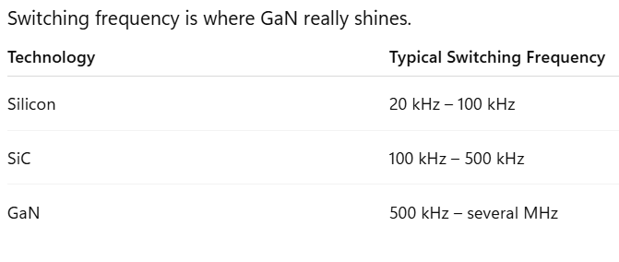
Switching Frequency
Switching Frequency is proportional to Switching Loss

Slide 7
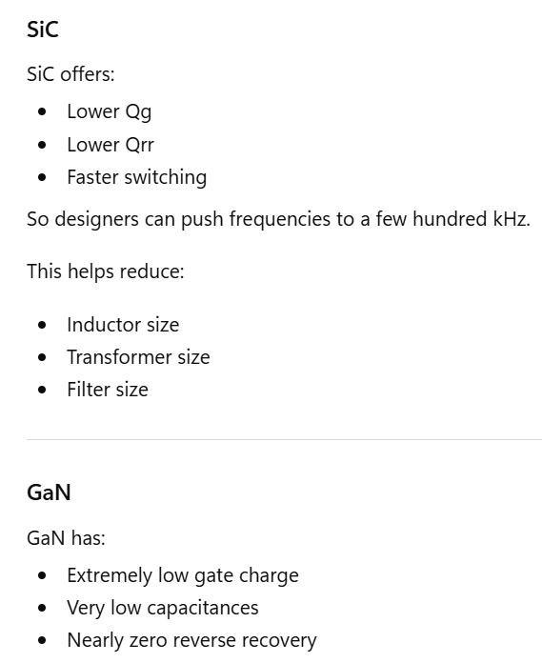
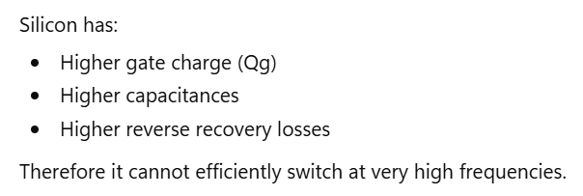
Comparison

Slide 8
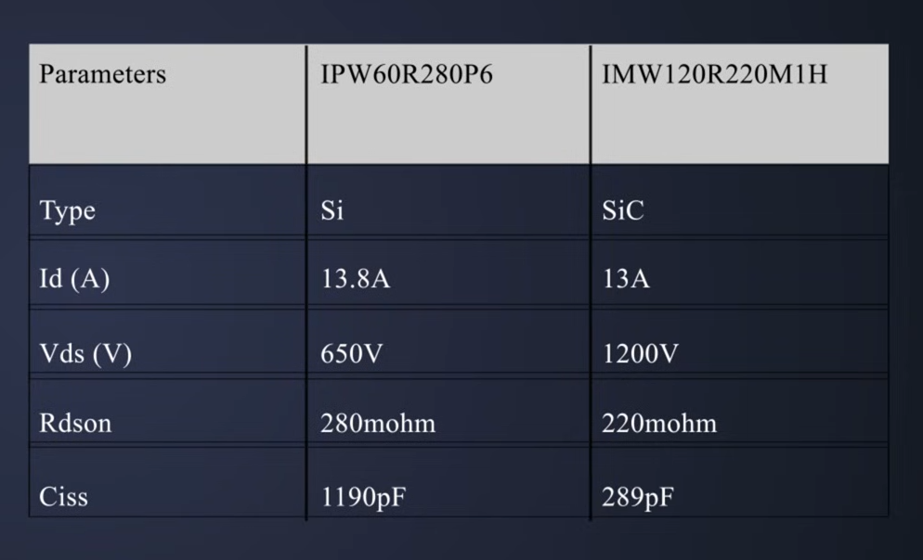

Slide 9
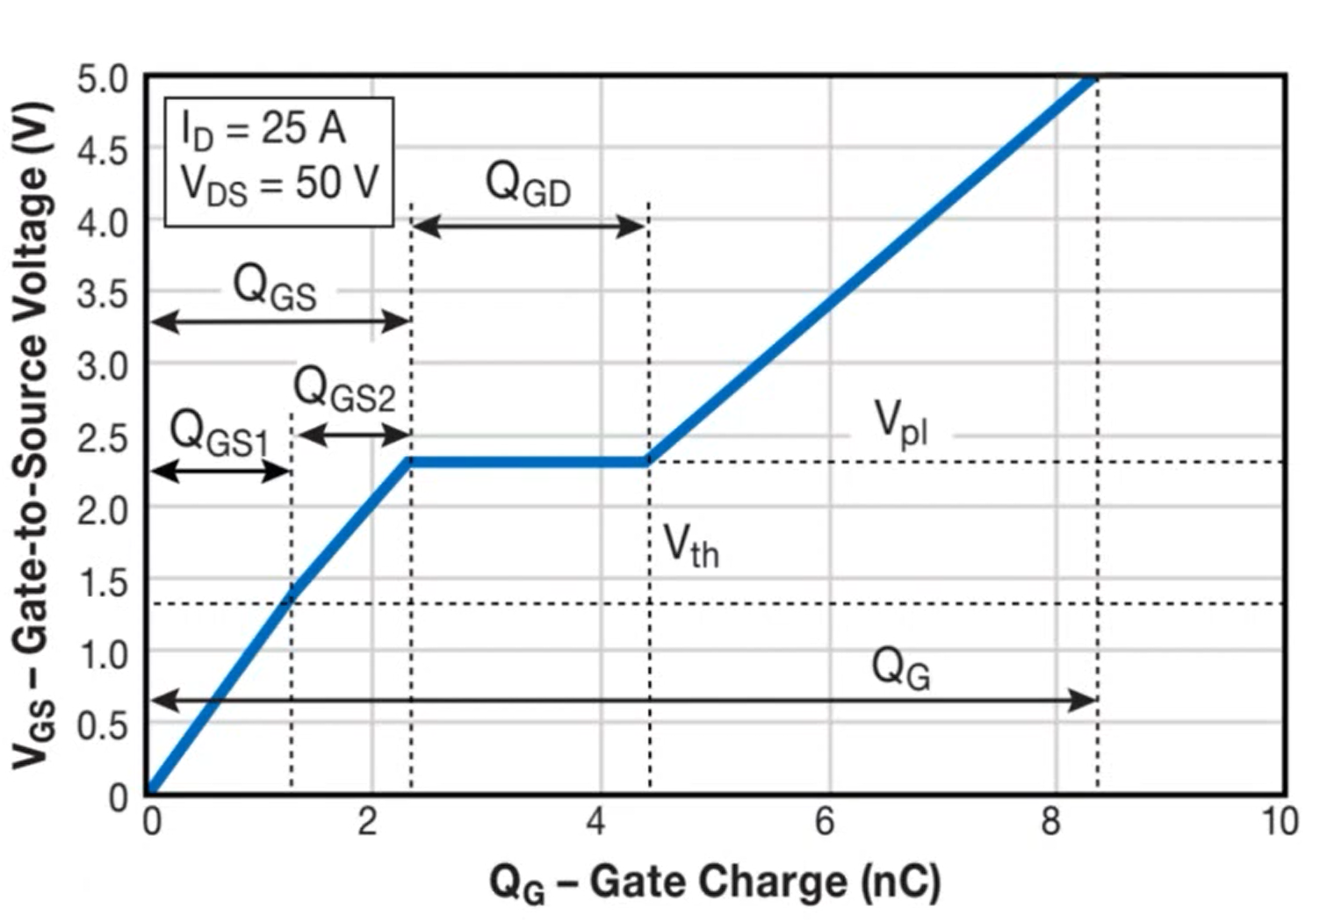

Slide 10
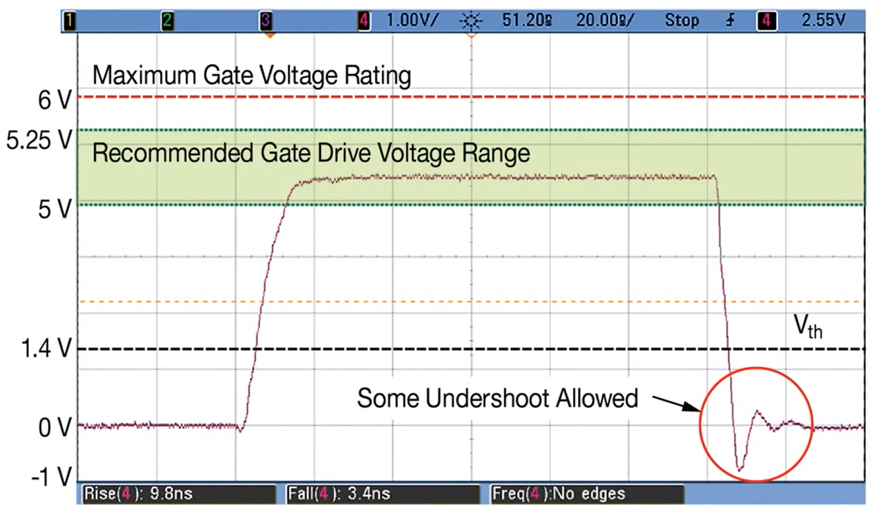

Slide 11
Precautionary measures for driving GaN transistors
Do Not Exceed Gate Voltage Limits
Use a regulated gate driver.
Prevent gate overshoot.
Minimize Gate Loop Inductance
Place driver very close to GaN.
Use short and wide PCB traces
Use Kelvin Source Connection
Reduces ground bounce.
Accurate VGS control.
Prevents false triggering.
Properly Select Gate Resistance
Switching speed
Overshoot
Ringing
EMI

Slide 12
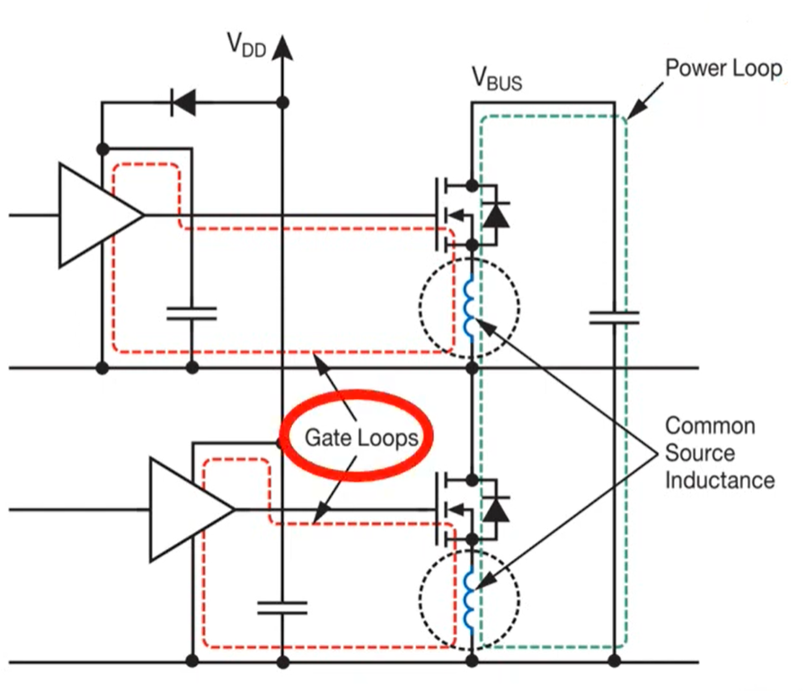
Parasitic Capacitance
2 loops
Gate Loop
Power Loop
Dangerous inductance called Common Source Inductance

Slide 13
Gate Loop
Gate Current changes rapidly, even though the current is small than power current.
Here switching is extremely fast.
Thus it can still create ringing.
Large gate loop -> Overshoot
Driver
↓
Gate
↓
Source
↓
Driver Ground
Layout Rule
Driver must be placed close to the GaN.

Slide 14
Power Loop
Bus Capacitor
↓
High-side GaN
↓
Switch Node
↓
Low-side GaN
↓
Back to Capacitor
Every PCB Trace has inductance. So if
power loop is large – large Inductance(L)
large Inductance(L) -> Voltage overshoot
Layout Rule
Put the DC-link capacitor extremely close to the half-bridge.

Slide 15
Common Source Inductance
The same source connection is used by both the loops
Power loop
Gate Loop
Suppose the power current changes dI = 20A then due to source inductance the source node moves like maybe to +2V for a few ns. But the gate driver is measuring Vgs. This is the root cause of
Ground bounce
False turn-on
False turn-off
Gate ringing

Slide 16
LMG3100R017
https://www.ti.com/product/LMG3100R017
https://www.ti.com/lit/ds/symlink/lmg3100r017.pdf?ts=1780359936031

Slide 17
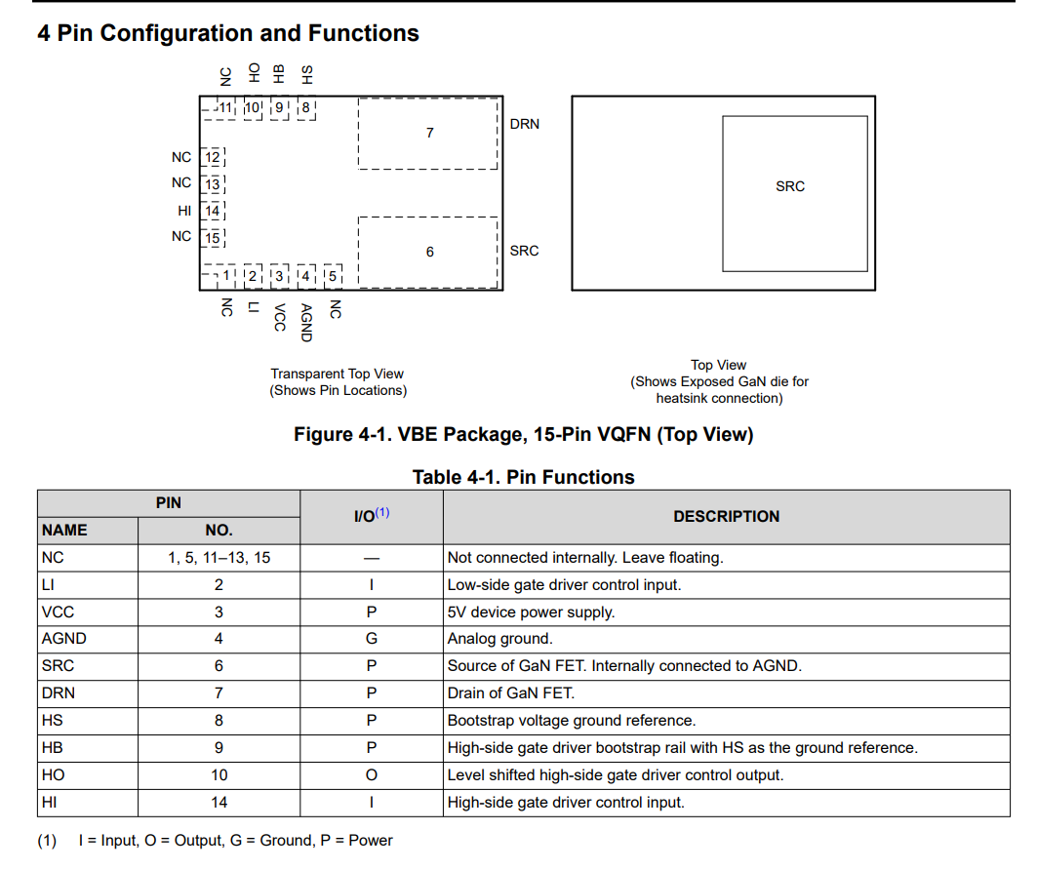

Slide 18
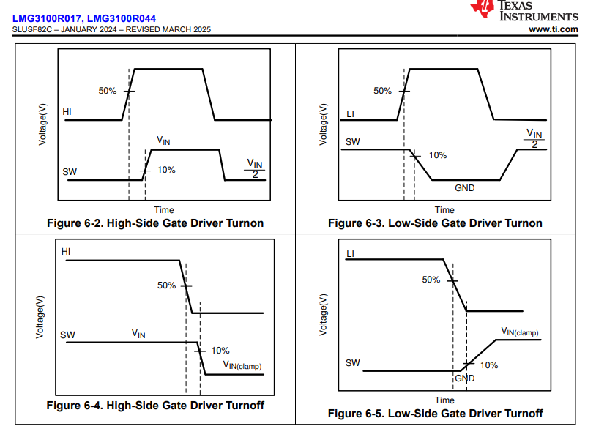

Slide 19
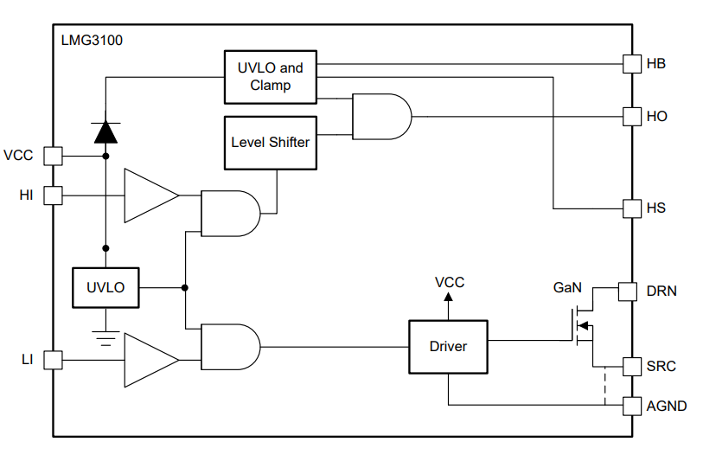

Slide 20
Feature Description
Driver and GaN are co-packaged → very low common source inductance.
Bootstrap clamp protects the GaN gate from excessive VGS.
Two UVLO protections:
VCC UVLO
HB-HS UVLO
Below UVLO, HI and LI are ignored.
Driver actively pulls the gate low during undervoltage conditions.
200 mV hysteresis prevents chattering.
Keep bypass and bootstrap capacitors extremely close to the device to minimize parasitic inductance.

Slide 21
Control Inputs
Supports Both 3.3V and 5V Logic
HI and LI are Independently Controlled
No Overlap (Shoot-Through) Protection
Designer Must Add Deadtime

Slide 22
Power Supply Recommendations
VCC Supply
Recommended operating range: 4.75V to 5.25V
Absolute maximum: 6V
Low-side gate is not internally clamped, so VCC must stay within range.
UVLO Hysteresis
Prevents repeated ON/OFF operation due to supply ripple.
Device continues operating until VCC drops below the UVLO threshold minus hysteresis.
VCC Bypass Capacitors
Place between VCC and AGND.
100 nF ceramic → high-frequency filtering.
220 nF to 10 µF ceramic → energy storage for driver operation.

Slide 23
Layout Guidelines
Keep the power loop area as small as possible.
Place the return current path directly below the forward current path.
Opposite current directions cause magnetic flux cancellation, which leads to less loop inductance.
Place Cvcc and Cboot as close to the GaN FET
AGND is the logic/driver reference ground.
Never directly connect AGND to PGND near the IC because PGND noise can couple into HI and LI and cause unwanted switching.

Slide 24
